Slide 1
Angular framework – Step 8

Slide 2
Angular framework
Angular is open source web framework which help to develop the SPA application.
Angular is a part of google company.
Angular use html, css and typescript.
Angular is component base architecture framework.
To create the angular project we need to use google provide angular cli.

Slide 3
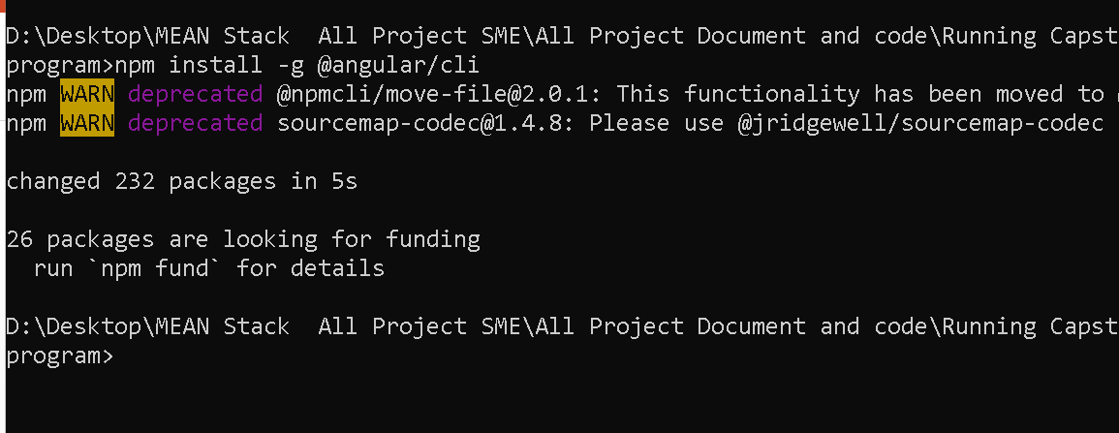
To enable angular-cli using the command as

Slide 4
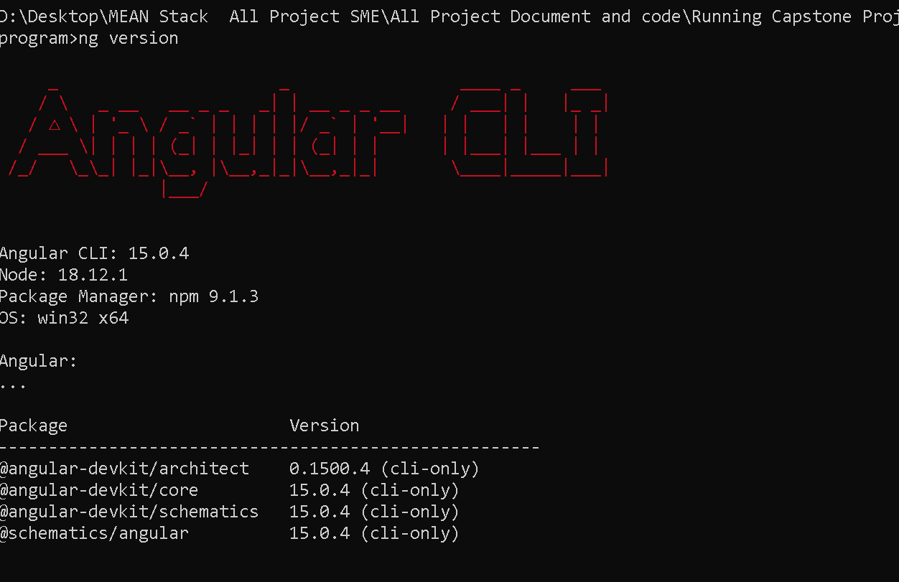
Verify angular cli

Slide 5
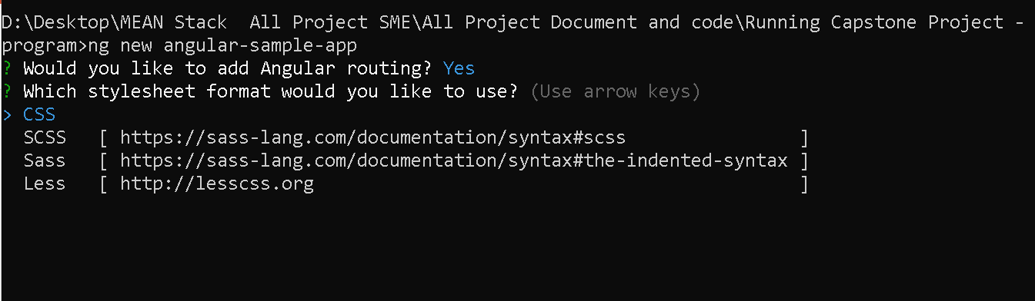
To create the angular project using command

Slide 6
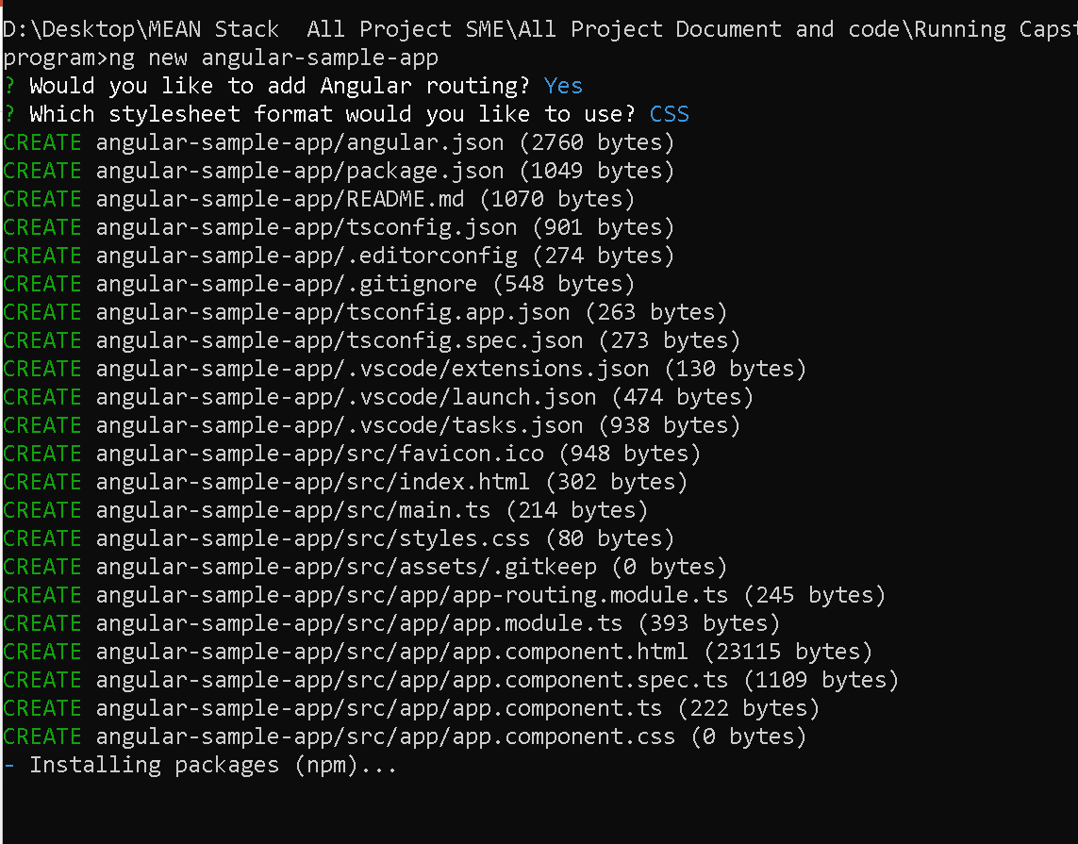
Sample project

Slide 7
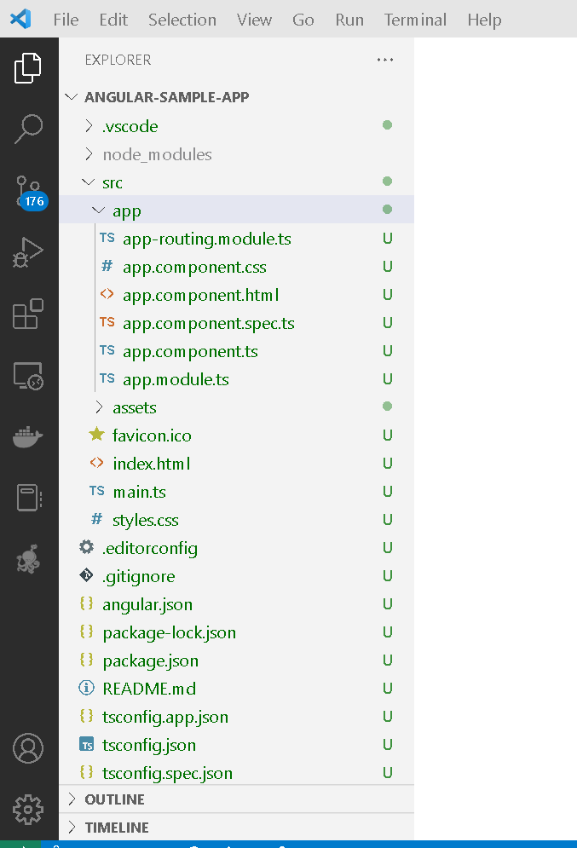
Angular project structure

Slide 8
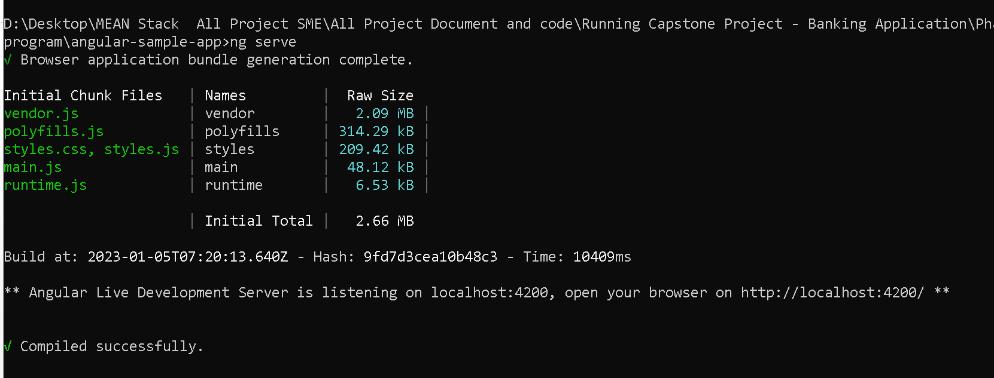
To run the angular sample project
We need to run the commands as
ng serve
It will run on default port number 4200

Slide 9
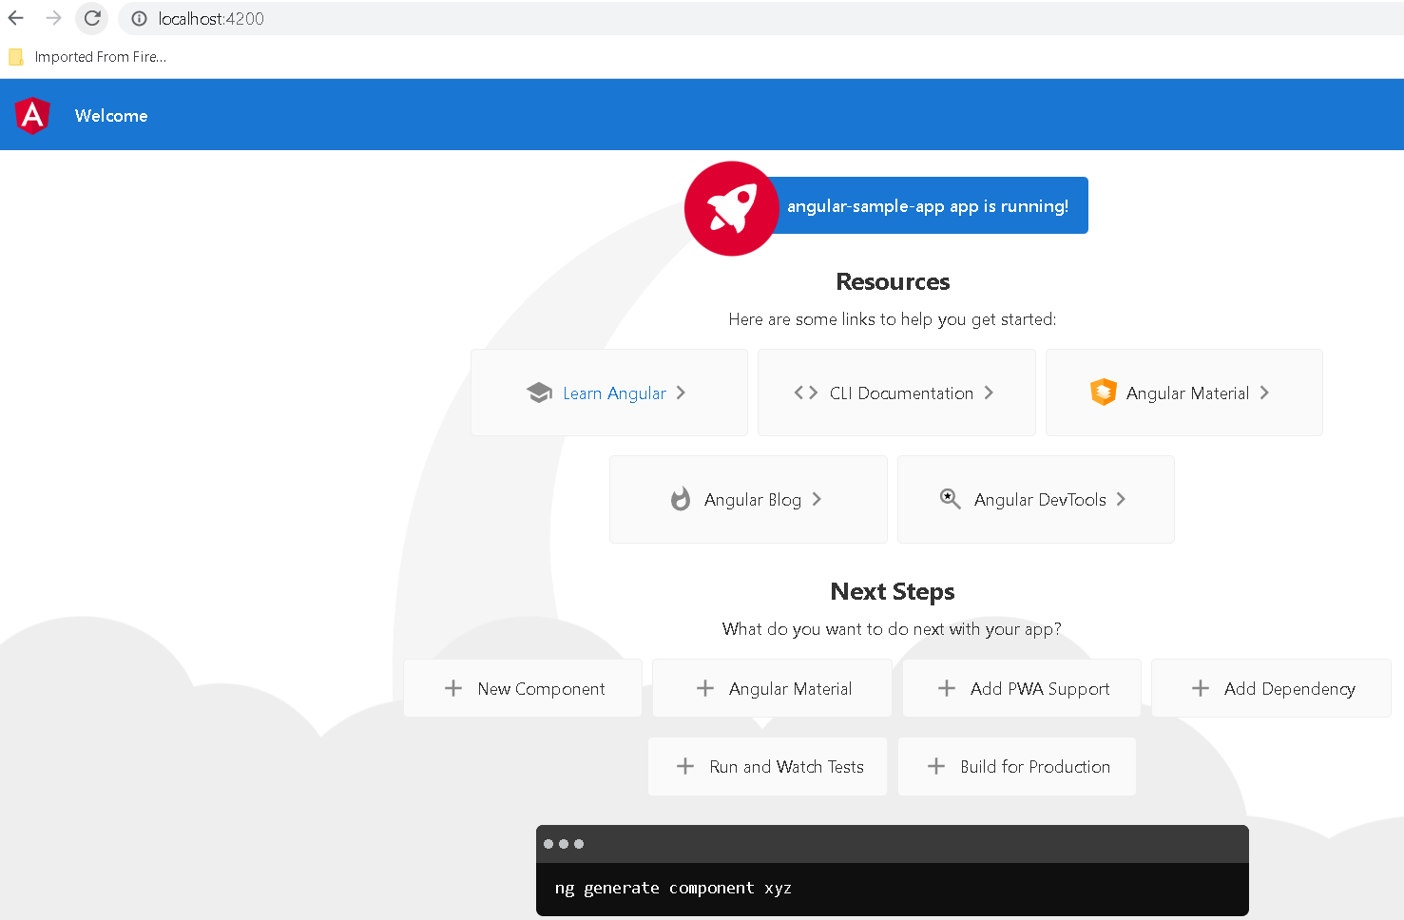
Sample angular project

Slide 10
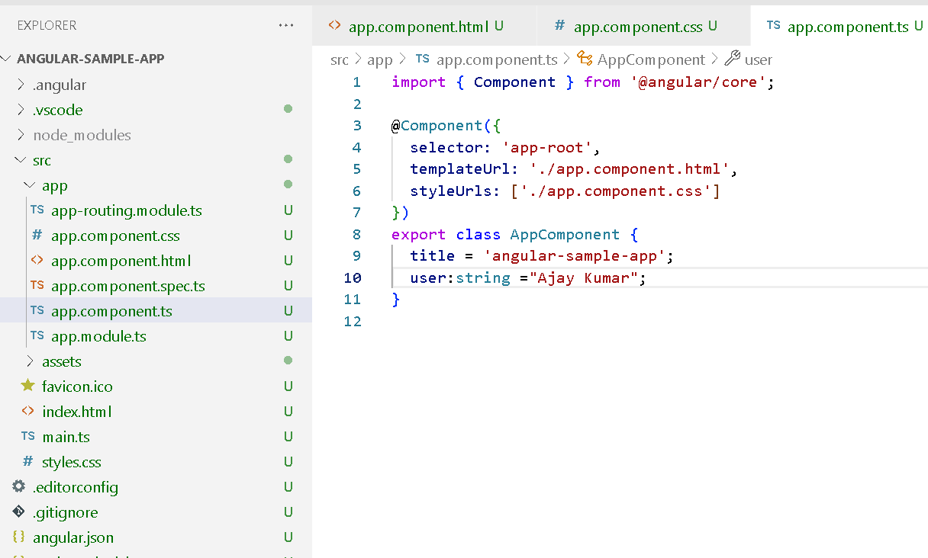
Edit in ts page
Src→app→app.component.ts

Slide 11
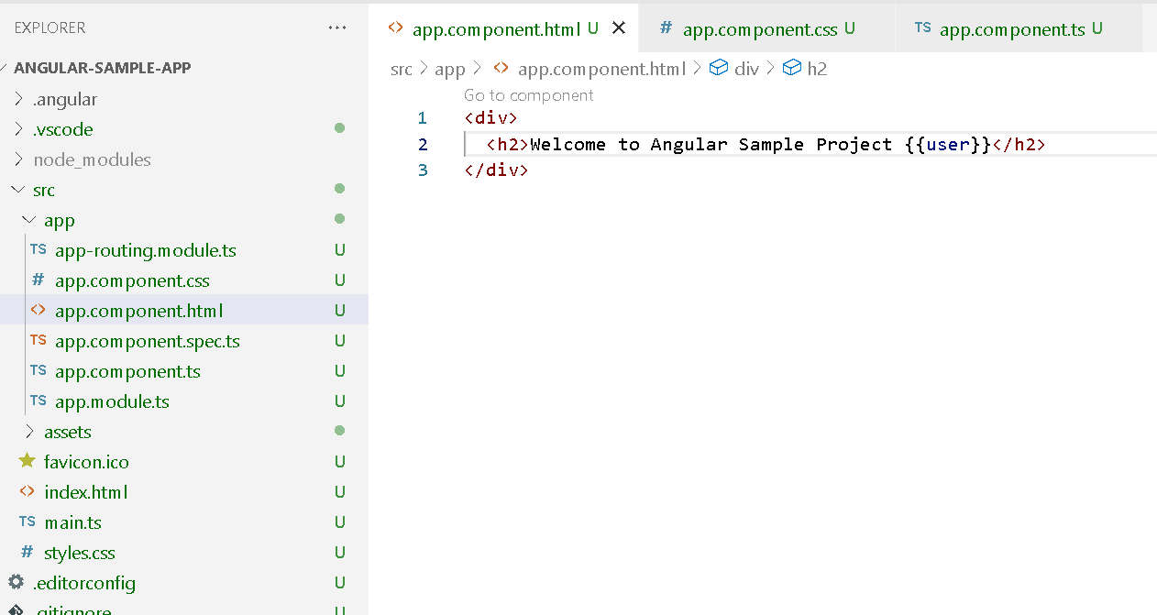
Edit in html page
src→ app→app.component.html page

Slide 12
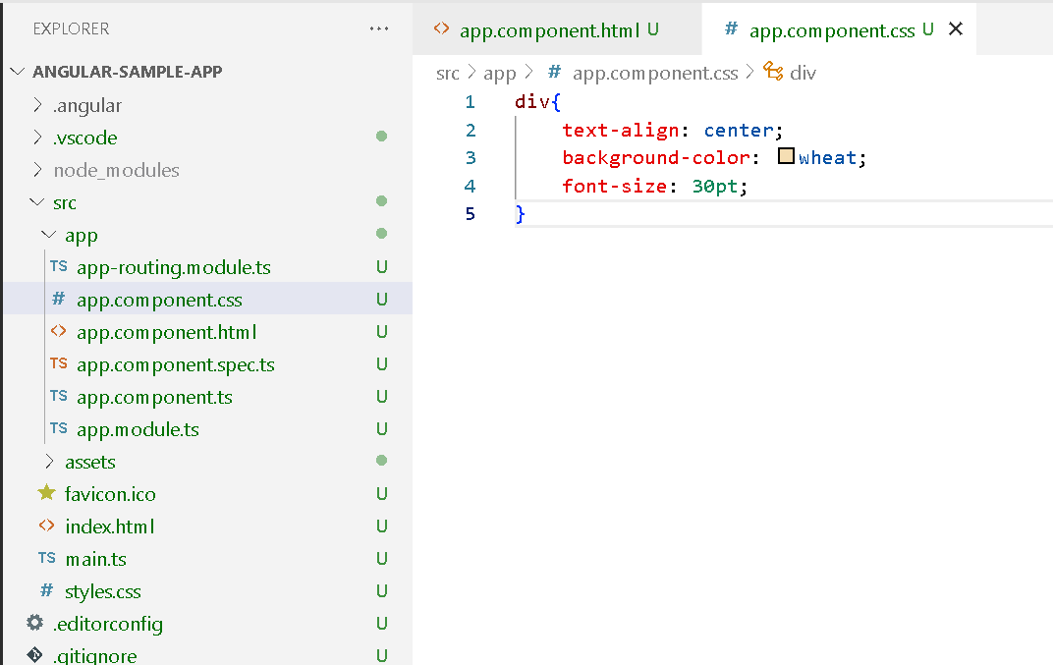
Edit in css page
Src→app→app.component.css

Slide 13
